Slide 1
Capstone Review
05/08/2024

Slide 2
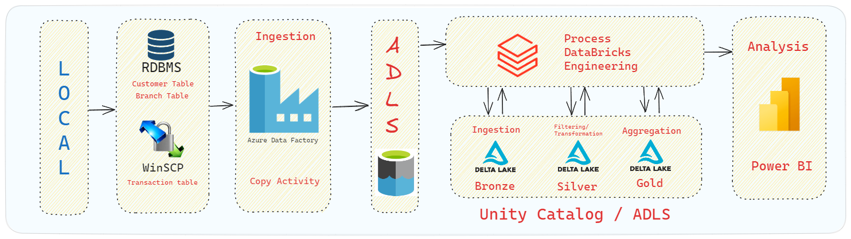
Workflow Proposed

Slide 3
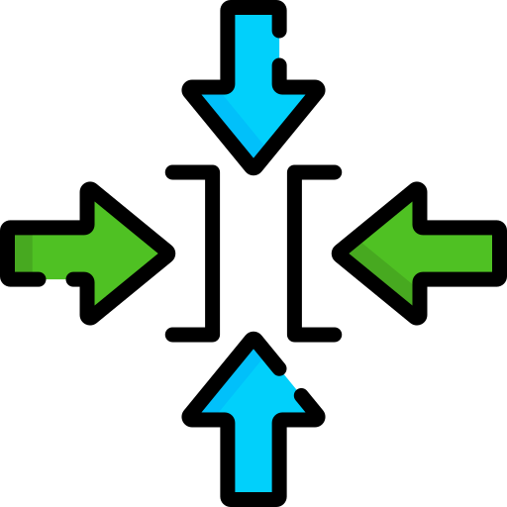
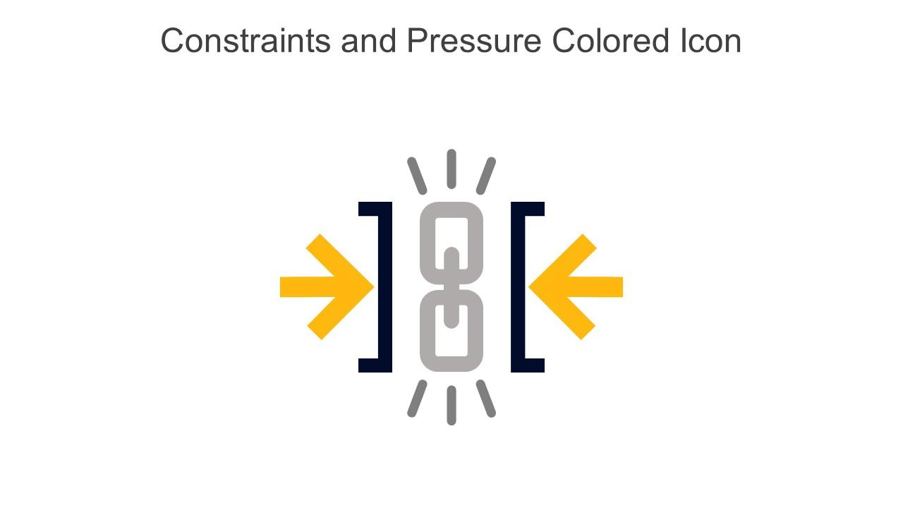
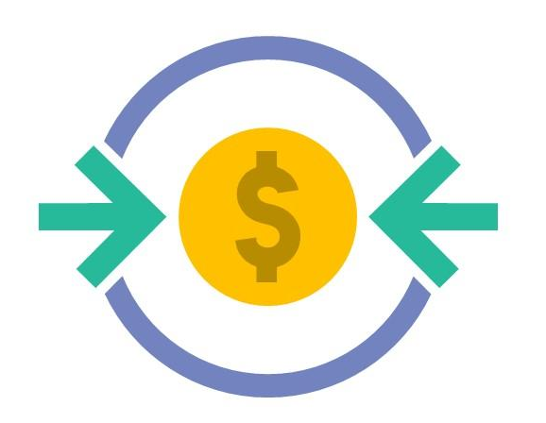
Constraints
Azure Data Factory (ADF) Restrictions: Unable to use ADF due to lab restrictions.
Delta Live Tables (DLT) Restrictions: Unable to use DLT due to lab restrictions.
Job Execution Limitation: Unable to run multiple jobs, impacting workflow orchestration.
Cost Concerns: Lab bills are prohibitively high for the basic resources required on Databricks.
Power BI Connectivity Issues: Unable to connect to Power BI from the lab due to restrictions.

Slide 4
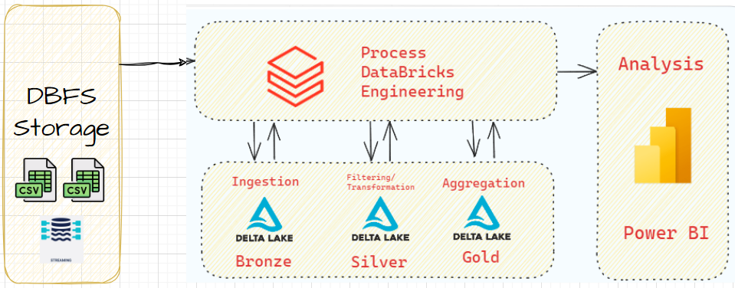
Workflow Applied

